Slide 1


Campus Safety Monitoring and Alerting System - Ensuring real-time safety insights and responsive measures for a secure campus environment through innovative data streaming and visualization technologies.
Campus Safety Monitoring System
by Calson Netshikulwe
and
Mahlatsi Mashilo

Slide 2
01
Real-Time Data Streaming
Our system utilizes Kafka for real-time streaming, ensuring timely alerts and data updates across the campus.
Interactive Dashboard Visualization
02
With Streamlit, users access an interactive dashboard that presents critical safety data and visual insights in real-time.
Proactive Safety Measures
03
Implementing temporal access denial enhances user safety by preventing anxiety and encouraging responsible behavior on campus.
Project Overview
Real-Time Campus Safety Monitoring using Kafka, Zookeeper, PostgreSQL, and Streamlit

Slide 3
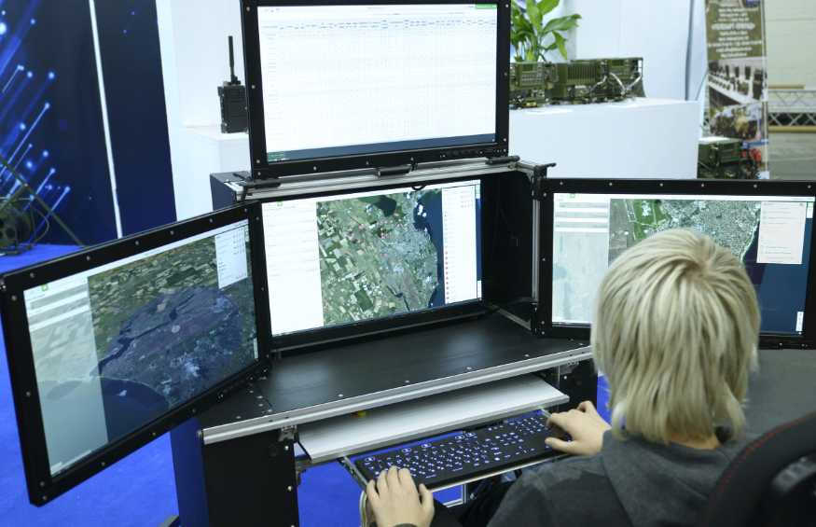


Engagement Drivers for Campus Safety Monitoring
The importance of real-time alerts and interactive dashboards in ensuring safety
Engaging users with real-time alerts and interactive dashboards provides immediate information on safety concerns. This not only keeps the campus informed but also enhances the overall awareness and responsiveness of students, staff, and security personnel to any potential threats.

Slide 4


Kafka enables efficient data streaming and real-time processing.
Comparing System Architecture and User Flow in Real-Time Monitoring
All components work together to enhance campus safety through timely information.
Analyzing how Kafka,Zookeper, PostgreSQL, and Streamlit interact for campus safety solutions.
PostgreSQL provides reliable data storage and management for the system.

Slide 5
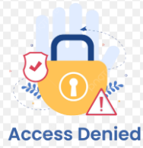
The Benefits of Temporary Access Denial
How limiting access can improve mental well-being and productivity
Temporary access denial effectively reduces anxiety by allowing individuals to focus on the present. It encourages a healthy balance between digital engagement and real-life experiences, ultimately preventing over-reliance on technology and fostering a more mindful approach to interactions.

Slide 6

Enforcement of Temporal Access Denial
Understanding Server-Level Controls and Their Role in Campus Safety
Implementing server-level controls and session limits allows for effective temporal access denial, ensuring that users are notified about their access levels. This approach not only enhances security but also promotes a balanced and healthy interaction with campus safety resources, reducing the likelihood of having fake reports.

Slide 7
Advantages of the System
Exploring how our campus safety system enhances real-time awareness and promotes responsible movement.
Real-Time Insights
Data-Driven Awareness
Scalability
Immediate data access improves safety response times.
Informed decisions based on accurate and timely data.
Easily adapts to growing campus needs and user demands.

Slide 8
Disadvantages of the System
Understanding potential concerns and challenges in campus safety monitoring and alerting systems
Possible Anxiety
Internet/Server Dependency
Data Accuracy Concerns
Users may experience stress from continuous alerts.
System relies heavily on stable internet connectivity.
Inaccurate data can lead to mistrust in the system.

Slide 9

Future Work in Campus Safety
Enhancing strategies for onboarding, monitoring engagement, and using ML for risk prediction
Our future work includes developing effective onboarding strategies to ensure user familiarity, monitoring engagement levels for continuous improvement, implementing temporal access denial for balanced usage, and utilizing machine learning to predict risks, enhancing campus safety measures.

Slide 10
References:
Han, Y., Guo, L. and Guo, Y., 2024. Interactive medical and safety monitoring in clinical trials. Contemporary Clinical Trials Communications, 36, p.101228. Available at: https://pmc.ncbi.nlm.nih.gov/articles/PMC11271019/ .
Liu, A., Wong, W.K. and Zhao, Y., 2023. The evolving role of data and safety monitoring boards for modern clinical trials. Contemporary Clinical Trials, 129, p.107218. Available at: https://pmc.ncbi.nlm.nih.gov/articles/PMC10514684/
UCLA Research Administration, 2023. Data and Safety Monitoring for Clinical Trials. University of California Los Angeles. Available at: https://www.researchgo.ucla.edu/data-safety-monitoring-clinical-tria
University of California Irvine, 2023. Data and Safety Monitoring for Clinical Research. Available at: https://research.uci.edu/human-research-protections/clinical-research/data-and-safety-monitoring-for-clinical-research
Mayo Clinic, 2023. Data and Safety Monitoring Guidelines. Mayo Clinic Research. Available at: https://www.mayo.edu/research/documents/43-data-and-safety-monitoring-guidelinespdf/doc-10026780
Hawkins, A.J., 2023. AAA study finds drivers improve after using smartphone monitoring apps. The Verge. Available at: https://www.theverge.com/news/642121/driving-smartphone-app-track-safety-ubi-aaa-resear.
Huckvale, K., Torous, J. and Larsen, M.E., 2020. Assessment of the clinical risks of mobile health apps: a systematic review. Journal of the American Medical Informatics Association, 27(2), pp.330–340. Available at: https://academic.oup.com/jamia/article/27/2/330/5585
compliance in Android mHealth apps: a cross-sectional study. arXiv preprint arXiv:2008.05864. Available at: https://arxiv.org/abs/2008.05864 [Accessed 1 September 2025].

